Slide 1
Welcome to all
for the MHRM Online lecture
By
Dr. Dhiraj Ovhal
HOD of Commerce

Slide 2
Chapter -2
Marketing Decision –I
(Product and Price)

Slide 3
Q.5 Product Positioning
Meaning:-
To create distinctive image and reputation in the mind of customers.

Slide 4
Product features:-
Price & Quality:-
Positioning by product class:-
Positioning by use:-
Positioning by user category:-
Positioning by competitors:-
Positioning by culture symbol :-
Positioning by corporate image:-
Positioning by emotions:-
Positioning by highlighting social issues:-
Positioning by highlighting social issues:-
Strategies:

Slide 5
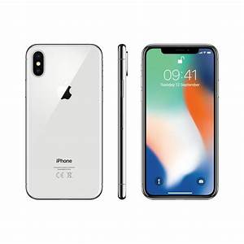
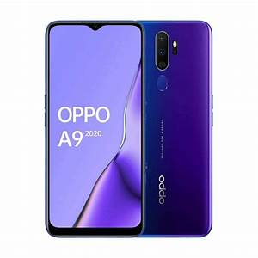
Product features :-
I-Phone-- Best quality, Oppo- Selfie camera,

Slide 6
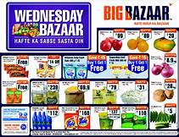
2. Price & Quality:-
Big bazar- discount ,
Newspaper- Saturday and Sunday maximum pages

Slide 7
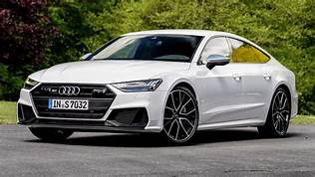
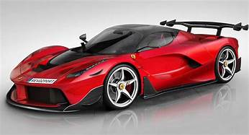
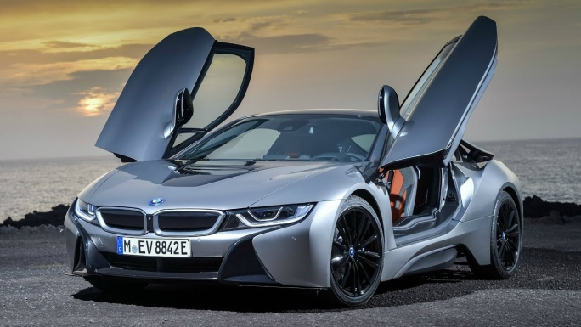
3. Positioning by product class:-
Audi, Ferrari, BMW-Luxurious car

Slide 8
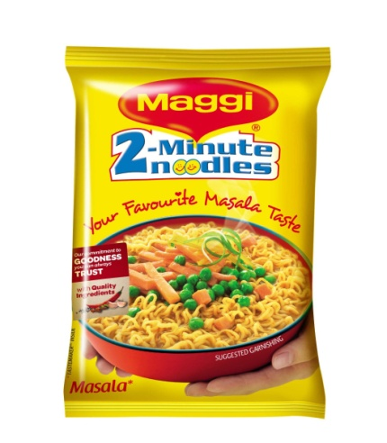
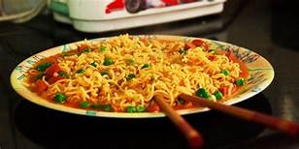
4. Positioning by product benefits:-
Maggie noodles-2 minutes easy to cook and eat

Slide 9
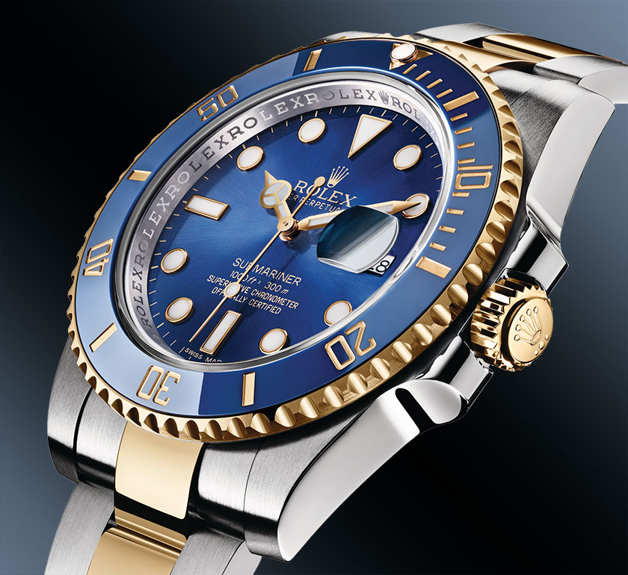
5. Positioning by use:-
Rolex watches, Sports Car, bikes
Rolex watches- highly costly with special design

Slide 10
6. Positioning by user category:-
Lux soap-bollywood actress
Luxurious Car- Upper Class

Slide 11
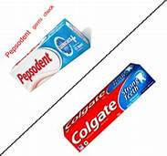
7. Positioning by competitors:-
Jio vs Airtel.
Colgate Vs Pepsodents.

Slide 12
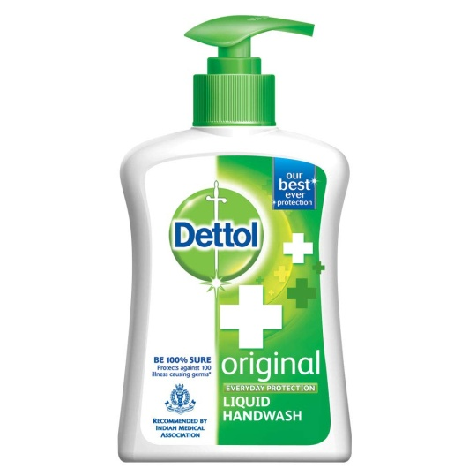
8. Positioning by culture symbol :-
Nike √,:- The name of Greek goddess
Dettol + :- The sign of + Indicate Hospital Care

Slide 13
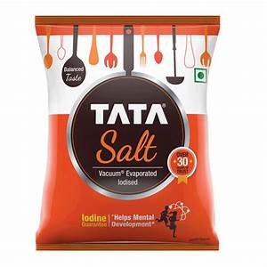
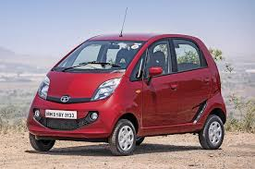
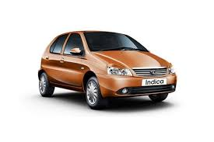
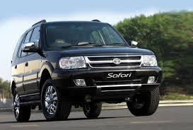
9. Positioning by corporate image:-
Tata Nano, Tata Salt, Tata all products

Slide 14
11. Positioning by highlighting social issues:-
Surf Excel- Girls éducation,
Corona Virus:- Stay Safe ,Stay Home
Hello Tune

Slide 15
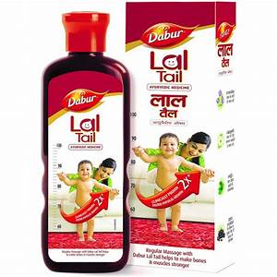
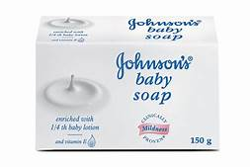
12. Positioning by emotions :-
Jhonson & Jhonsons Soap,
Dabur lal tel

Slide 16
Product features:-
Price & Quality:-
Positioning by product class:-
Positioning by use:-
Positioning by user category:-
Positioning by competitors:-
Positioning by culture symbol :-
Positioning by corporate image:-
Positioning by emotions:-
Positioning by highlighting social issues:-
Positioning by highlighting social issues:-
Strategies:

Slide 17
Thank You

